Slide 1
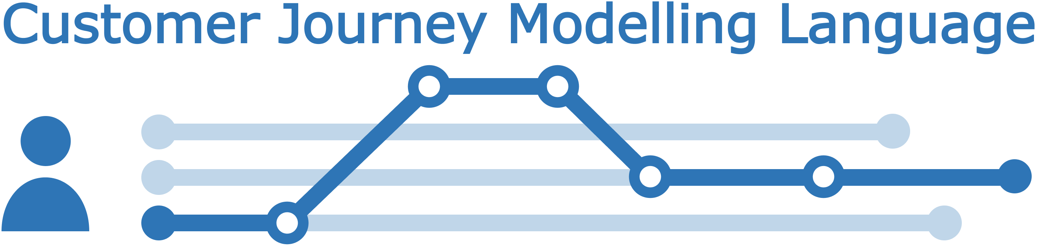
Visual notation
CJML - Customer Journey Modelling Language
Version 2.0
SINTEF Digital
November 2022

Slide 2



Overview of CJML 2.0 resources
The CJML material consists of several modules that are to be seen in connection to each other.
All the CJML resources, including tools and documentation, can be found here: www.cjml.no
Introduction
Overview, purpose and target group
Modelling approach
Visual notation
Diagrams types and symbols
Features and examples
Diagram generator
Templates for easy diagramming
Examples
Main change in this version:
An expanded terminology and a data exchange format
Change in the visual notation of the journey network diagram (message flow between sender and receiver)
Terminology
Definitions, attributes, and class diagrams
Meta-model
Data format
XML schema
XML examples
XML description
CJML v2.0 by SINTEF Digital is licensed under the Creative Commons Attribution-ShareAlike 4.0 International License.
The current version of CJML was developed in the research project Smart Journey Mining funded by the Research Council of Norway (grant no. 312198).

Slide 3
Content
Readers guide
  Who can use this material?
  Additional resources
Overview
  Core visual elements
  The two diagram types
  Representation of basic attributes
Symbols
  About the use of symbols
  Actors and user experience
  Communication channels
Customer journey diagram
  Touchpoints and attributes
  Compliance
  Journey phase
  Decision point
  Summary of visual syntax
Journey network diagram
  Touchpoints and attributes
  Compliance
  Journey phase and time
  Summary of visual syntax
Customer- and user experience
  General principles
  Visualisation of customer experience
Appendix
  Extra features: Sub-symbols, timeline, unordered
  and uncertain sequences, and concurrency
  Examples – plain journey diagram
  Examples – deviation diagram
  Examples – journey network diagram

Slide 4
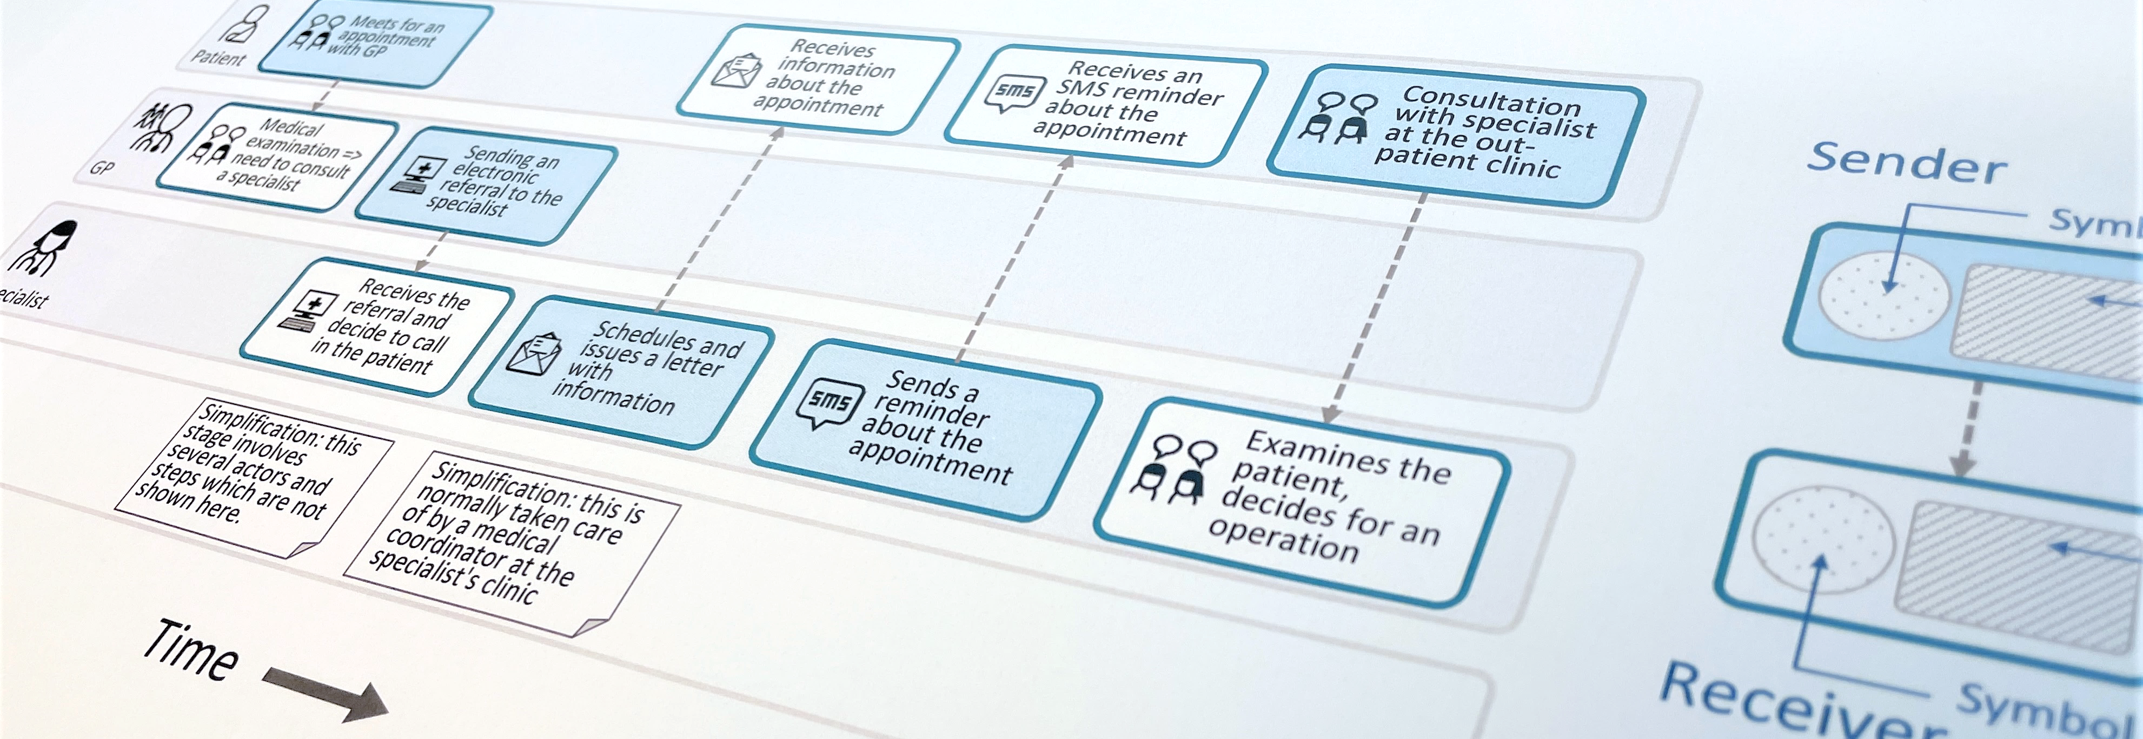
CJML - Customer Journey Modelling Language
CJML is a visual language dedicated to modelling of human journeys, regardless of whether the human has the role of customer, user, patient, or citizen.
Customer journey
User journey
Employee journey
Patient journey
Citizen journey

Slide 5
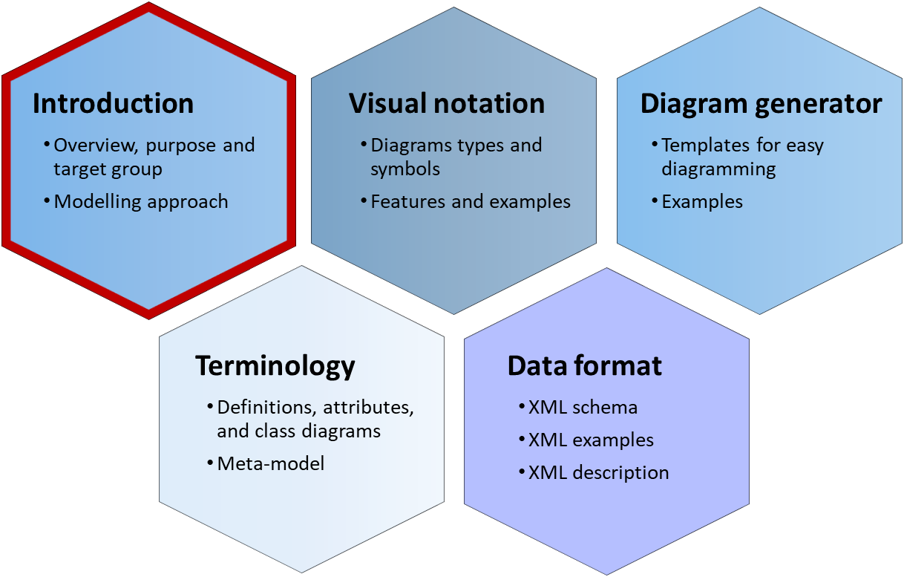
Overview
This is the basics of the visual notation. The following slides assume that you are familiar with the “theory” of CJML, as presented in the Introduction module.
Core visual elements
Main diagram types
Representation of basic attributes

Slide 6
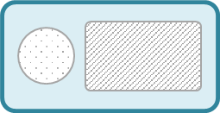

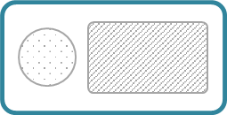
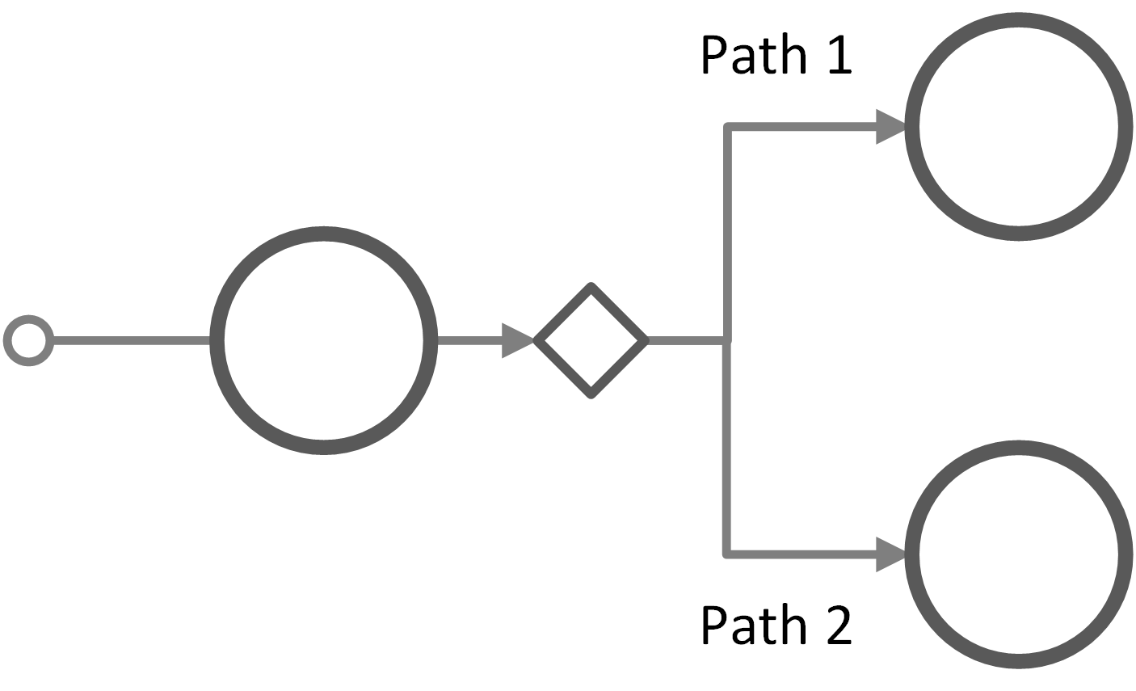











Core visual elements of CJML
Flow objects - customer journey diagram
Flow objects - journey network diagram
Start of journey
Communication point
Action
Communication point
Action
text area
Rules for the colour
text area
Symbol
Direction of the message
text area
End of journey
Channel symbol
text area
Connecting object
Decision point
Connecting objects
Swimlane
Sequence flow
Sequence flow (optional)
Message flow
Actor
Symbols (both diagram types)
Communication channel
Actor
Experience
Overview
Symbols
Customer journey diagram
Journey network diagram
Customer experience
Appendix

Slide 7

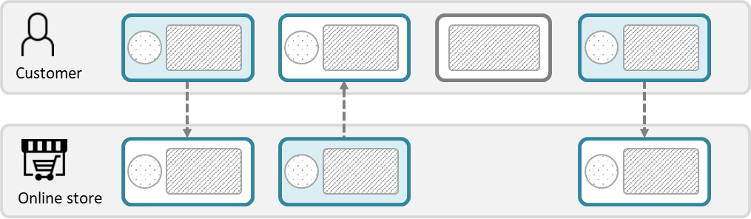

Diagram types – planned journey
Customer journey diagram
Suitable when focusing only on the end-user
Suitable when few actors are involved
Journey network diagram (“swimlane diagram”)
Suitable when several actors are involved
Reveals both the sender and the receiver of a communication point
Emphasizes the direction of the message flow
The boundary colours are free of choice, but must be consistent (representing the initiating actor).
This diagram has two predefined colours, distinguishing the initiator from the receiver.
There is an implicit time axis running from left to right
Time
Note the difference in how a communication point appears in the two diagram types.
Overview
Symbols
Customer journey diagram
Journey network diagram
Customer experience
Appendix

Slide 8
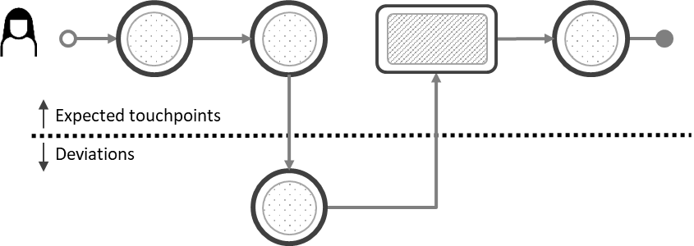
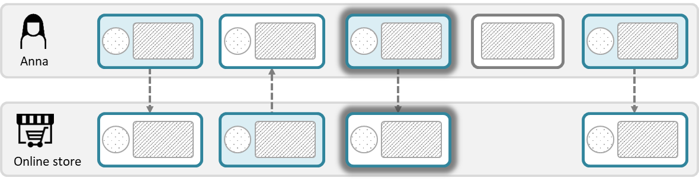
Diagram types – actual journey
Customer journey diagram
Suitable when focusing only on the end-user
Suitable when few actors are involved
Suitable when emphasizing deviations from the planned journey
Journey network diagram (“swimlane diagram”)
Suitable when several actors are involved
Reveals both the sender and the receiver of a communication point
Emphasizes the direction of the message flow
Ad-hoc touchpoints also appear differently in the two diagram types.
Overview
Symbols
Customer journey diagram
Journey network diagram
Customer experience
Appendix

Slide 9
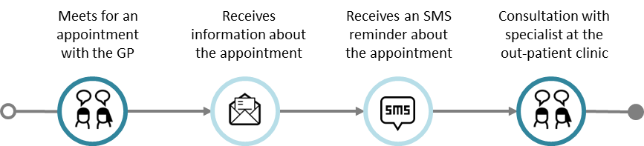
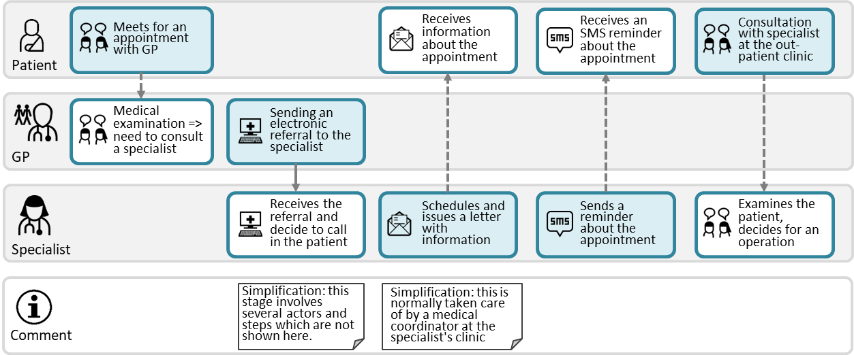
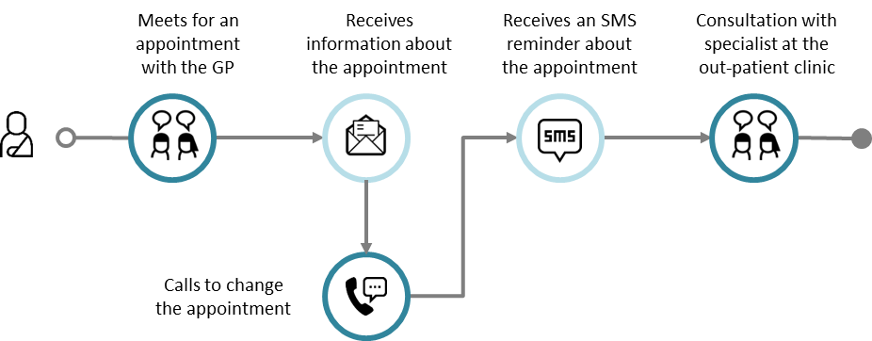
Example: Referral to a specialist
Journey diagram
Example of planned journey
Example of actual journey with a deviation
Journey network diagram
The patient journey in the upper swimlane corresponds to the planned patient journey to the left
The swimlane diagrams shows all the individual journeys at once, and it also reveals the exchange between the GP and the Specialist, which is not part of the patient journey
Planned journey
Actual journey
This is an example of a deviation from the planned journey
Overview
Symbols
Customer journey diagram
Journey network diagram
Customer experience
Appendix

Slide 10











Comparison of diagram types
Note the correspondence with the upper swimlane
Meets for an appointment with the GP
Receives information about the appointment
Receives an SMS reminder about
the appointment
Consultation with specialist at the
out-patient clinic
Journey diagram
(patient journey)
Journey network diagram
(“swimlane” diagram)
Meets for an appointment with GP
Receives information about the appointment
Receives an SMS reminder about the appointment
Consultation with specialist at the out-patient clinic
Patient
Medical examination => need to consult a specialist
Sending an electronic referral to the specialist
GP
Note that this touchpoint is invisible to the patient (and thus not part of the patient's journey above)
Receives the referral and decide to call in the patient
Schedules and issues a letter with information
Sends a reminder about the appointment
Examines the patient, decides for an operation
Specialist
Simplification: this stage involves several actors and steps which are not shown here.
Simplification: this is normally taken care of by a medical coordinator at the specialist's clinic
Comment
Overview
Symbols
Customer journey diagram
Journey network diagram
Customer experience
Appendix

Slide 11

Representation of basic attributes
CJML offers two ways to represent a communication point, corresponding to the two distinct diagram types
The figure illustrates how the representation changes in accordance to the direction of the communication.
From Actor 1 to Actor 2
From Actor 2 to Actor 1
Message
Message
Communication channel
Communication channel
Actor 1
(initiator)
Actor 2
(receiver)
Actor 1
(receiver)
Actor 2
(initiator)
Diagram type 1
Diagram type 2
Diagram type 1
Diagram type 2
Communication channel
Communication channel
text area
text area
Actor 1
(initiator)
Actor 1
(receiver)
direction
direction
Actor2
(receiver)
text area
Actor 2
(initiator)
text area
Overview
Symbols
Customer journey diagram
Journey network diagram
Customer experience
Appendix

Slide 12
Symbols
About the use of symbols
Actors and user experience
Communication channels

Slide 13


About the use of symbols
CJML has a special version for cyber security with symbols used to annotate touchpoints, e.g., “threat” and “unwanted incident.” See more information here: www.cjml.no/horm
The symbols are used mainly for three purposes:
  To represent actors
  To represent communication channels
  To represent end-user experience (actual journeys only)
Symbols for communication channels
  CJML has a set of preferred symbols but we also provide alternatives
Actor symbols are provided for various contexts:
  General service context
  Healthcare context
  Cybersecurity context
Actor
Citizen / Sandra
Communication channel
E-mail
End-user experience
Unsatisfied
Overview
Symbols
Customer journey diagram
Journey network diagram
Customer experience
Appendix

Slide 14















































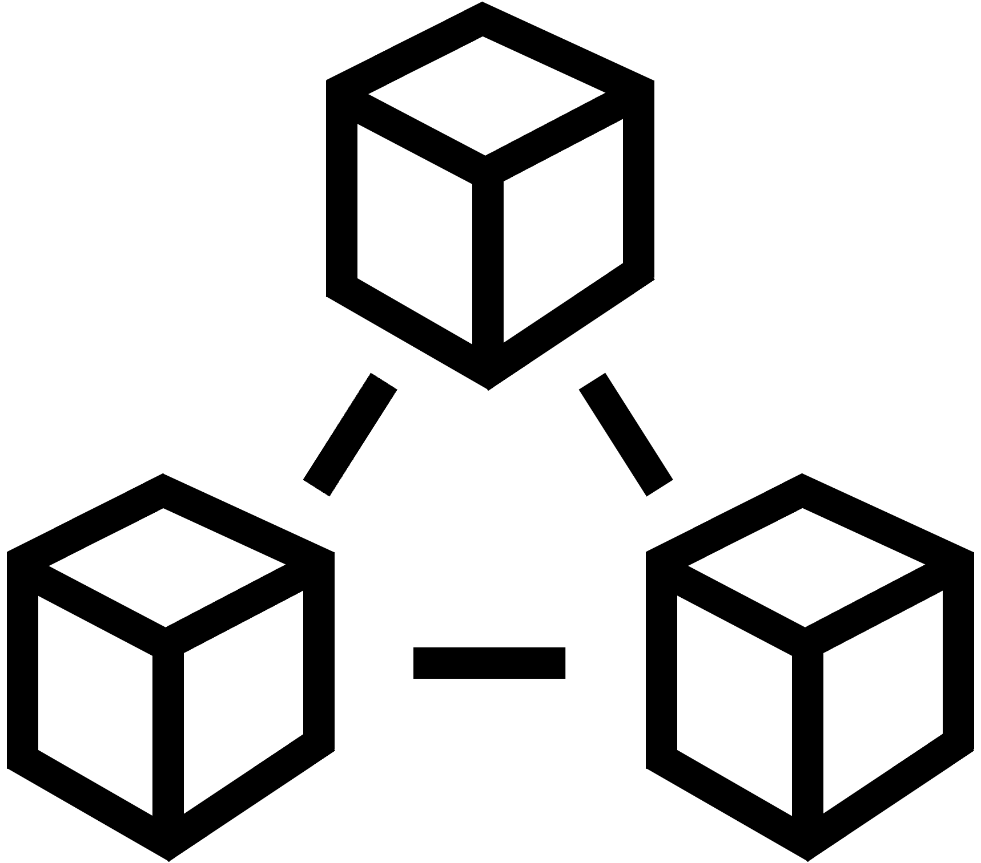

Overview - actors and user experience
General symbols
Users and customers
user13
user14
user15
user16
user17
user18
user19
user20
user21
user1
user2
user3
user4
user5
user6
user7
user8
user9
user10
user11
user12
Service providers
service provider1
service provider2
service provider3
service provider4
service provider5
service provider6
store1
store2
store3
store4
online store1
online store2
bank1 online
bank2 online
bank3
bank4
bank5
bank6
Employee - general
employee7
employee8
employee9
employee10
employee11
employee12
employee13
employee14
employee15
employee16
employee1
employee2
employee3
employee4
employee5
employee6
IT staff and technicians
User/customer experience
staff IT1
staff IT2
staff3 IT3
staff tech1
staff tech2
staff tech3
Platforms and systems
1 very unsatisfied
2 unsatisfied
3 neutral
4 satisfied
5 very satisfied
tech1 database
tech2 database
tech3 server
tech4 virtual machine
tech5 cloud
tech6 network
tech7 system
tech8 system cloud
Overview
Symbols
Customer journey diagram
Journey network diagram
Customer experience
Appendix

Slide 15




























Communication channels (1/2)
General symbols
Default
Alternative
Default
Alternative
telephone conversation
internet via PC
internet via smartphone
SMS
internet via tablet
e-mail
social media message
app on PC
message service
app on smartphone
chat
app on tablet
face-to-face interaction
internet/globe
Overview
Symbols
Customer journey diagram
Journey network diagram
Customer experience
Appendix

Slide 16
























Communication channels (2/2)
General symbols
Default
Alternative
Default
Alternative
self-service machine
payment channel or bank transaction
letter
package delivery
fax message
unknown channel
shop counter
service desk
Overview
Symbols
Customer journey diagram
Journey network diagram
Customer experience
Appendix

Slide 17




















Healthcare actor symbols
Healthcare symbols
Patients
patient-1
patient-2
patient-3
Doctors and surgeons
Health secretaries
doctor-1
doctor-2
doctor-3
doctor-4
health-secretary-1
health-secretary-2
secretary-receptionist-1
secretary-receptionist-2
Nurses
Health systems
nurse-1
nurse-2
nurse-3
nurse-4
chief-nurse
hospital-computer-system
hospital-post-office
patient-medical-record-1
patient-medical-record-2
patient-medical-record-3
Hospitals and health systems
hospital-1
hospital-2
hospital-3
hospital-4
Overview
Symbols
Customer journey diagram
Journey network diagram
Customer experience
Appendix

Slide 18








































Healthcare actor symbols - extra
Healthcare symbols
doctor - general practitioner
doctors
surgeons
anaesthesiologists
nurses
chief nurses
health secretaries
secretaries/receptionists
medical practices
Overview
Symbols
Customer journey diagram
Journey network diagram
Customer experience
Appendix

Slide 19



















Cyber security symbols
Cyber security symbols
Cyber security experts
cyber security expert 1
cyber security expert 2
cyber security expert 3
cyber security expert 4
cyber security expert 5
cyber security expert 6
cyber security expert 7
cyber security expert 8
cyber security expert 9
Attackers / cyber criminals
attacker
attacker network
attacker physical
attacker software
attacker social engineering
Special symbols
threat
unwanted incident
vulnerability lock
vulnerability unlock
firewall
danger2
Overview
Symbols
Customer journey diagram
Journey network diagram
Customer experience
Appendix

Slide 20
Customer journey diagram
Touchpoints and attributes
Compliance
Journey phase
Decision point
Summary of visual syntax

Slide 21

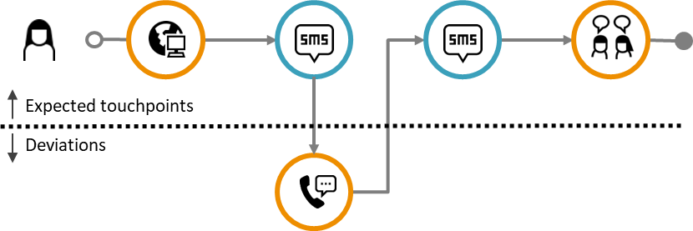
Introducing the customer journey diagram
This is the simplest journey diagram, having a dedicated focus on the end-user. It comes in two variants:
The diagram comes in two variants:
  Plain journey diagram: A linear chain of touchpoints in the order of appearance. Here, no attention is given to deviations and conformance.
  Deviation diagram: This diagram emphasizes any deviation from the planned journey.
Plain journey diagram
Deviation diagram
Planned journey
The deviation diagram is reserved for actual journeys. Here, it is easier to spot deviations, e.g., the unexpected call from the customer.
Actual journey
Actual journey
The end-user’s icon is always included for actual journeys (otherwise the actual journey would be identical to the planned journey when there are no deviations).
Overview
Symbols
Customer journey diagram
Journey network diagram
Customer experience
Appendix

Slide 22


Communication points
A tradition in CJML is to use orange colour for a customer, and teal blue for a patient.
Communication point boundary
Communication points are represented as a circle
The circle's boundary style carries information about
the actor initiating the touchpoint
the status of the touchpoint
The symbol in the middle represents the communication channel or the device being used
symbol area
Examples
Actor
The colour indicates the actor who initiated the communication point.
Orange is often used for the customer or end-user
If many actors are involved, a journey network diagram may be more suitable
Customer
Service providers
Anna calls the service company
Service company sends an e-mail
Patient
Doctor
Patient meets for a medical consultation
Hospital sends an SMS reminder
Compliance (actual journeys only)
The boundary style indicates the status of the communication point
solid boundary: completed (as expected) or ad-hoc
dashed boundary: missing
crossed touchpoint: failing
Completed and ad-hoc
Missing
Failing
Customer fails to buy a train ticket
Customer didn’t receive the call
Overview
Symbols
Customer journey diagram
Journey network diagram
Customer experience
Appendix

Slide 23
Actions
Distinguishing external actions from regular actions is not mandatory. It is more an opportunity if nuancing is important.
Actions are touchpoints that do not involve communication.
Actions are visually represented as rounded squares containing text.
Two types of actions may be distinguished:
  Actions that involve parts of the service system (e.g. looking at the display of arrivals at the train station).
  External actions that don’t involve the service system (e.g. writing down questions for the doctor before the appointment).
Action
text area
External action
text area
text description
text description
External action (not involving the service system)
Action (involving service system)
Overview
Symbols
Customer journey diagram
Journey network diagram
Customer experience
Appendix

Slide 24
Labels and touchpoint ID
Touchpoint ID
T1
T2
T3
T4
Label
<Text describing T1>
<Text describing T2>
<Text describing T3>
<Text describing T4>
Touchpoint IDs provides an unambiguous referral to touchpoints in a journey.
For planned journeys we recommend to use T1, T2, etc.
For actual journeys we recommend to use T1, T2, etc. for expected touchpoints and D1, D2, D3, etc. for deviations.
Labels add a description of the context:
We recommend to keep the description short
When rich descriptions are needed, the diagram can be accompanied by a table holding the explanations and a reference to the identifiers.
Overview
Symbols
Customer journey diagram
Journey network diagram
Customer experience
Appendix

Slide 25
Compliance
Compliance can be addressed “globally” on the level of a journey, but also locally on the level of touchpoints.
Journey compliance
  An actual journey may contain all the planned touchpoints, however in a wrong sequence. Such sequence errors are easily spotted in a deviation diagram (see separate slide about this).
  An actual journey may have deviations in the content of the touchpoint, e.g., in the message or objects carried by communication points. This content compliance is not visually emphasized.
Touchpoint compliance
  A communication point in an actual journey can be compliant (planned) or non-compliant (deviating). The types of deviations are:
  ad hoc (unbroken circle boundary)
  failing (crossed)
  missing (dotted boundary)
Overview
Symbols
Customer journey diagram
Journey network diagram
Customer experience
Appendix

Slide 26
Sequence error
actual journey
A touchpoint that takes place sooner or later than expected may result in a sequence error.
Sequence errors are visualised via the connectors in the following way:
  "Jump forward": When a touchpoint occurs before it was expected, the connector should start from the bottom of the touchpoint it originated from, and end at the bottom of the following touchpoint (see connector A in the figure).
  "Jump backward": When a touchpoint occurs later than expected, the connector should start from the top of the touchpoint it originates from, and end at the bottom of the following touchpoint (see connector B in the figure).
  From a deviation: When the sequence error originates from an ad-hoc-, missing- , or failing touchpoint, the connector should start to the right of the touchpoint and end at the bottom of the following touchpoint when the sequence error consists of a "jump" forwards (see connector C in the figure).
The actual sequence of touchpoints is revealed by following the connectors.
Connector B
Connector A
Connector C
Overview
Symbols
Customer journey diagram
Journey network diagram
Customer experience
Appendix

Slide 27
Journey phase
A customer journey can be divided into phases when convenient. The journey phases can for example be based on touchpoints that occur at a certain location.
Example: air travel
  Phase 1: Ordering ticket and preparing for the trip
  Phase 2: At the airport
  Phase 3: During the flight
  Phase 4: Arrival at the destination airport
Example: healthcare service
  Phase 1: Diagnosis
  Phase 2: Treatment
  Phase 3: Rehabilitation
Journey phase 1
Journey phase 2
Overview
Symbols
Customer journey diagram
Journey network diagram
Customer experience
Appendix

Slide 28
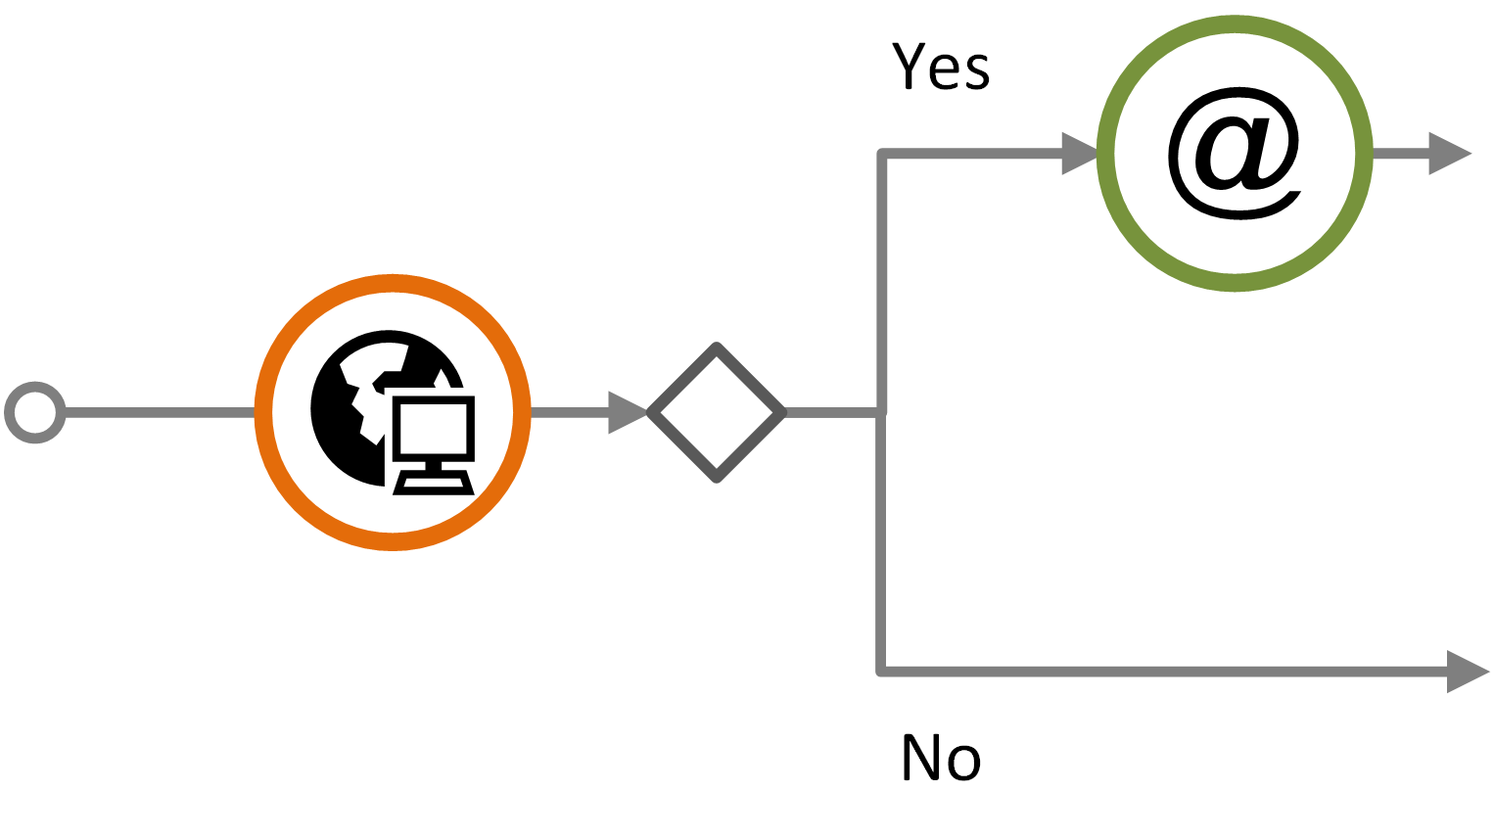
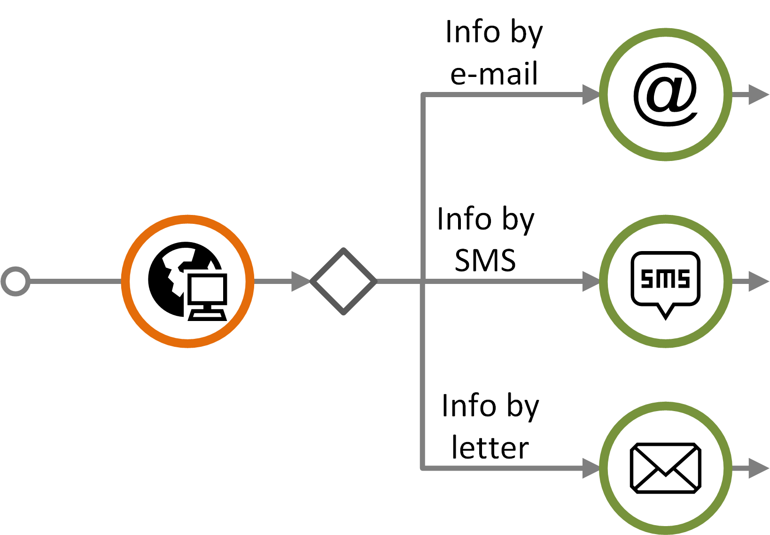
Decision point
Examples
Decision points are used for planned and generic journeys, and refer to points in time where a journey branches into several possible paths.
  A decision can be in control of the customer
  A decision can also be the service provider's option
Decision points are used when there are two or more path alternatives.
Does the customer want to receive information from the service provider by e-mail?
How does the customer want to receive information from the service provider?
Overview
Symbols
Customer journey diagram
Journey network diagram
Customer experience
Appendix

Slide 29
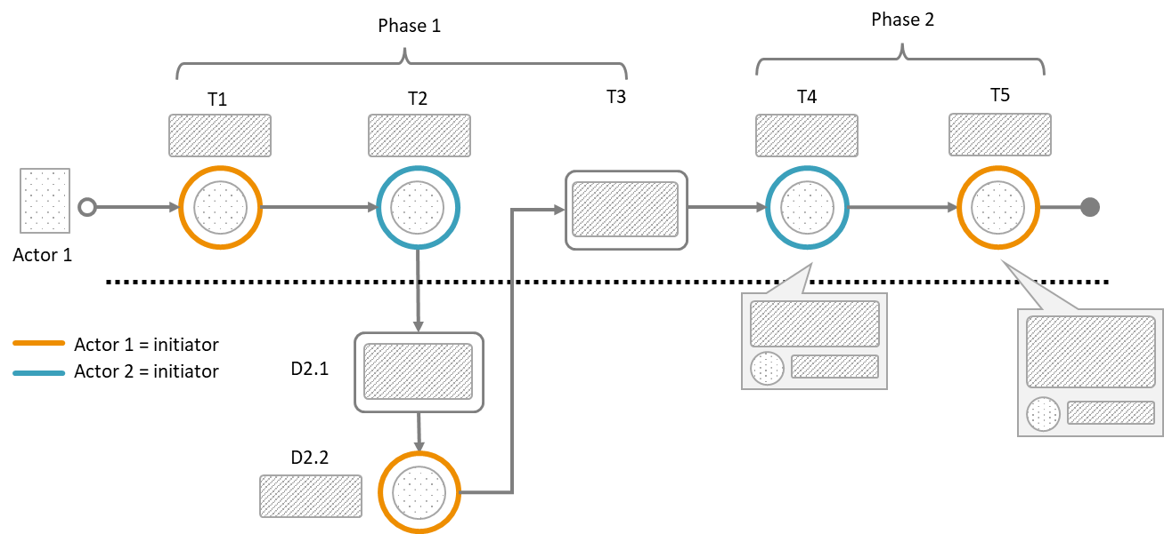
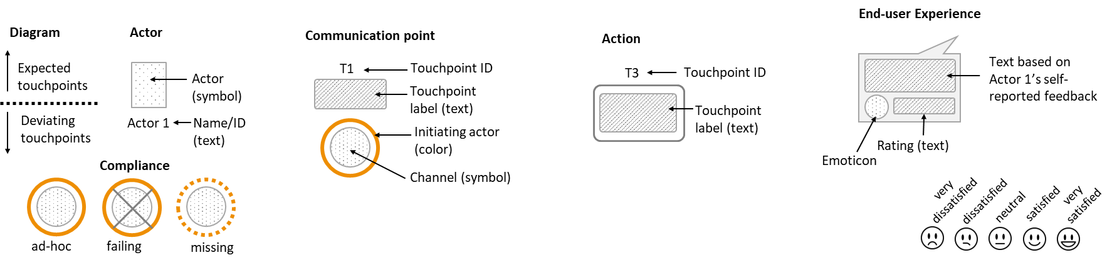
Summary of visual syntax - Customer Journey Diagram
Legend
Overview
Symbols
Customer journey diagram
Journey network diagram
Customer experience
Appendix

Slide 30
Journey network diagram
Touchpoints and attributes
Compliance
Journey phase and time
Summary of visual syntax

Slide 31

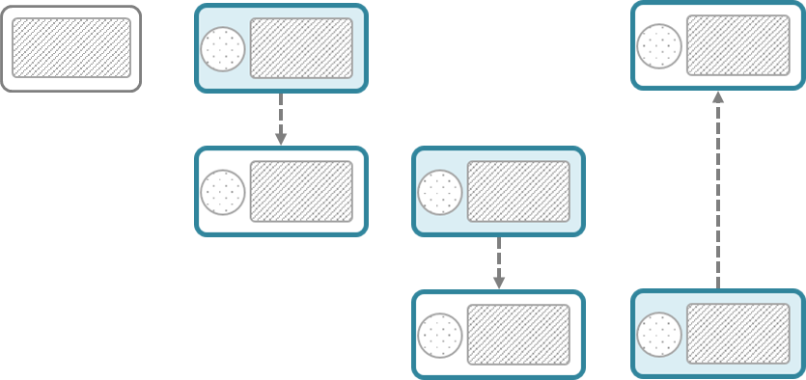


Basics – journey network diagram (1/2)
This diagram is also referred to as “swimlane diagram”
Touchpoints
The actors involved in the journey appear in separate swimlanes.
Actor 1
Time
Direction of the message flow
Actor 2
Actor 3
Actors represented in the diagram can be people, organisations, or systems.
Note that there is an implicit time axis in the diagram running from left to right
Overview
Symbols
Customer journey diagram
Journey network diagram
Customer experience
Appendix

Slide 32


Basics – journey network diagram (2/2)
A communication point has a sender (initiator) and a receiver that must be positioned in the corresponding swimlanes of the actors.
Action
Communication point
Communication point
Communication point
Sender
text area
Communication channel
direction
text area
Actor 1
Receiver
Actor 2
An action element is used for non-communicating events
Actor 3
Text area
Comment
Add an extra swimlane for comments if explanations are needed.
Overview
Symbols
Customer journey diagram
Journey network diagram
Customer experience
Appendix

Slide 33
Compliance
Sender
Receiver
Compliance can be addressed in case of actual journeys as deviations from the planned journey.
The shape's boundary style carries information about the touchpoint status, as illustrated to the right.
When it is important to outline deviations relative to a planned journey, a customer journey deviation diagram may be more suitable.
Journey network diagrams are generally not suitable for sequence errors.
Normal
Missing
Failing
Ad-hoc
Overview
Symbols
Customer journey diagram
Journey network diagram
Customer experience
Appendix

Slide 34
Journey phase and time
Date and time
Date and time
Duration
Date and time
Date and time
Phases and time indicators can also be added to a swimlane diagram.
Phase 1
Phase 2
WAITING TIME
Actor 1
Actor 2
Actor 3
Comment
Overview
Symbols
Customer journey diagram
Journey network diagram
Customer experience
Appendix

Slide 35




Example: Health service process
A patient visits a general practitioner and is referred to a specialist
After some waiting time the patient visits the specialist at an out-patient clinic
Date/time
Date/time
General practitioner's office
Out-patient clinic
Meets at local medical centre for an appointment with GP
Receives letter with date and time for appointment
WAITING TIME
Receives SMS-reminder about the appointment
Meets at specialist clinic for an examination
Patient
Medical examination of patient => need to consult a specialist
GP prepares and sends an electronic referral to the specialist
GP
Receives the referral and decide to call in the patient
Schedules and sends letter about appointment
Sends notification about the appointment
Examines the patient, decides for an operation
Specialist
Simplification: this is normally taken care of by a medical coordinator at the specialist clinic
Comment
Overview
Symbols
Customer journey diagram
Journey network diagram
Customer experience
Appendix

Slide 36
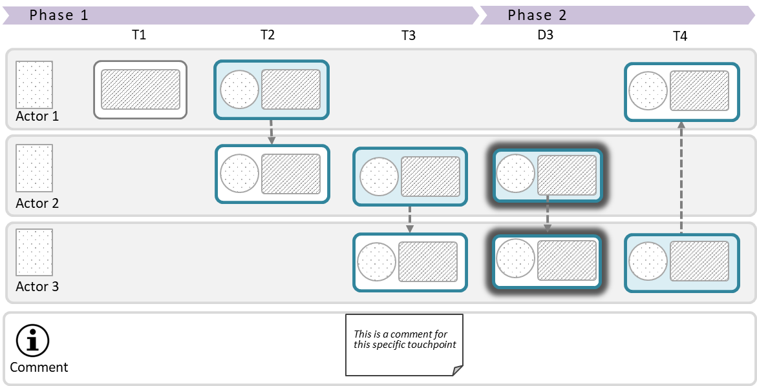
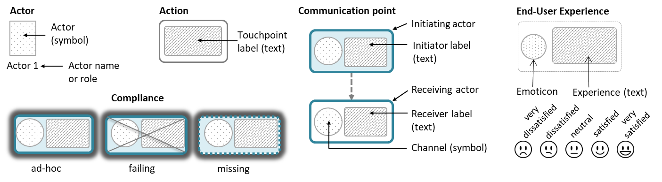
Summary of visual syntax - Journey Network Diagram
Legend
Overview
Overview
Symbols
Symbols
Customer journey diagram
Customer journey diagram
Appendix
Journey network diagram
Appendix
Journey network diagram
Customer experience
Customer experience

Slide 37
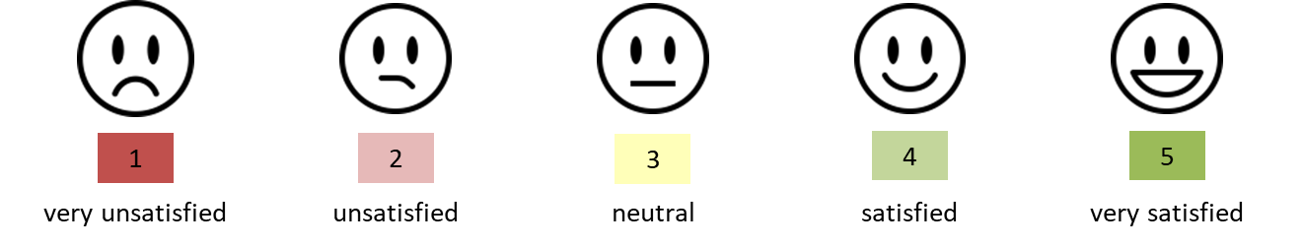
Customer/User experience
General principles
Visualisation of customer experience

Slide 38
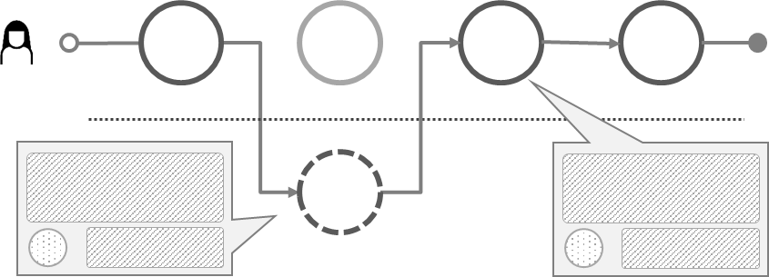
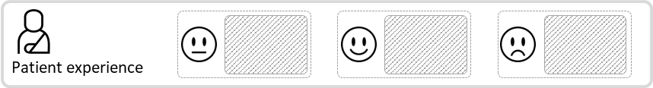
Customer/User experience
CJML insists that a user's experience is individual and thus cannot be assigned to a journey on a general level. In this way, CJML differs from the majority of other customer journey approaches.
When representing user experience (UX), CJML adheres to principles from HCI research;
  UX is subjective
  UX is dynamic
  UX is context dependent
UX is thus associated with actual journeys only.
UX is based on a user's self-reported input.
  Otherwise it must be flagged as "anticipated user experience"
UX can be expressed in various ways, depending on the diagram type.
  Swimlane diagram: in a separate swimlane
  Journey diagram: as call-outs from a communication point
See for example Law, E. et al. (2009). Understanding, scoping and defining user experience: a survey approach. Proceedings of 27th SIGCHI conference on Human factors in computing systems (pp. 719-728).
Journey network diagram
Customer journey diagram
Emoticon based on rating
Text based on user's self-reported input
Text based on user's self-reported input
Emoticon based on rating
Overview
Symbols
Customer journey diagram
Journey network diagram
Customer experience
Appendix

Slide 39
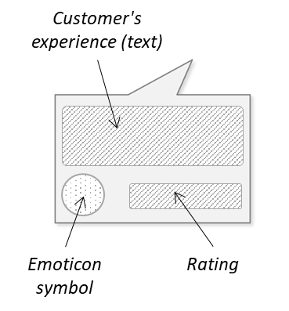
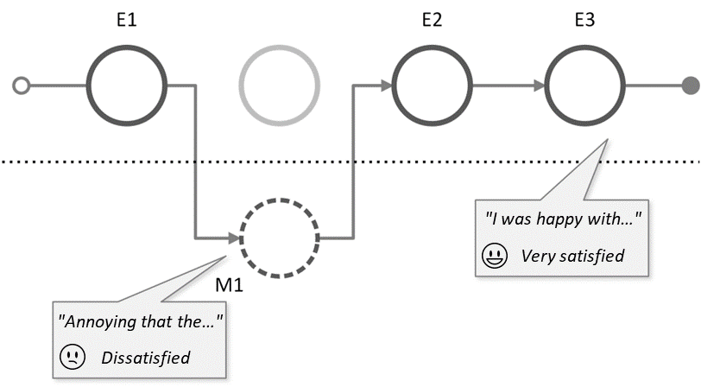

Customer experience symbols
Actual journey
CJML conveys CX in two different ways:
  Textual description based on the customer's own formulation
  Symbols representing the customer's rating. Smiley symbols are used to visualize the customer's experience
The symbols can be used to match both a 3-point and a 5-point Likert scale.
The CJML language supports CX in customer journey diagrams (using callout or table), as shown in the following slides.
The CX symbols may also be inserted directly into the diagram in the close vicinity of a touchpoint.
Overview
Symbols
Customer journey diagram
Journey network diagram
Customer experience
Appendix

Slide 40



Customer experience – callout
Actual journey
The example shows the use of callouts to express customer experience.
T1
T2
T3
T4
T5
order and pay ticket via web
e-mail confirmation
SMS confirmation
retrieve ticket
ticket control at entrance
It was easy to order the tickets. I just chose the movie I wanted to see, selected a seat, and put in my payment details.
Very satisfied
I don't understand why I get this information on SMS when I also received it on e-mail.
Unsatisfied
The queue for getting into the movie theatre was a bit long, but the person at the entrance was very friendly and helpful.
Satisfied
Overview
Symbols
Customer journey diagram
Journey network diagram
Customer experience
Appendix

Slide 41
Customer experience – table
Actual journey
The example shows the use of a table to express customer experience.
T1
T2
T3
T4
T5
order and pay ticket via web
e-mail confirmation
SMS confirmation
retrieve ticket
ticket control at entrance
Label | Touchpoints | Customer experience | Score
T1 | Order and pay via web | It was easy to order the tickets. I just chose the movie I wanted to see, selected a seat, and put in my payment details. | 5
T2 | E-mail confirmation | It was nice to get an e-mail confirming my ticket purchase. | 4
T3 | SMS confirmation | I don't understand why I get this information on SMS when I also received it on e-mail. | 2
T4 | Retrieve ticket | I got a bit confused because the ticket machine was not so intuitive, but it went OK and I managed to retrieve my tickets. | 3
T5 | Ticket control at entrance | The queue for getting the tickets was a bit long, but the person at the service desk was very friendly and helpful. | 4
Overview
Symbols
Customer journey diagram
Journey network diagram
Customer experience
Appendix

Slide 42



Customer experience - journey network diagram
The end-user experience data can be outlined in a separate swimlane.
Patient
General practitioner
Hospital
Rating or emoticon
User's self-reported content (text)
Patient experience
Overview
Symbols
Customer journey diagram
Journey network diagram
Customer experience
Appendix

Slide 43

Example – patient experience
BOOKING OF APPOINTMENT
OUTPATIENT CLINIC
April 13th 1 p.m.
April 18th
April 27th
April 30th
I need to book a new appointment at the outpatient clinic, but it is already too late.
Calls the outpatient clinic to book an appointment.
Receives a reminder.
Meets at the outpatient clinic.
Sara
General practitioner
Neurologist
Allocates an hour on April 30th.
Sends a reminder.
Takes blood samples and administers infusion.
Nurse, MS clinic
Calling hours are from 8 -11 a.m. This is too limited. I would like to call after lunch time!
I could not have the time that suited me best.
A reminder with date, time, building and link to exact location.
I met a new nurse. He was skilled and very friendly.
Sara's experience
Overview
Symbols
Customer journey diagram
Journey network diagram
Customer experience
Appendix

Slide 44
Appendix
Some of the examples in this appendix may contain visuals that are not the newest version. Still, the features and examples should be informative.
Extra features: Sub-symbols, timeline, unordered and uncertain sequences, and concurrency
Examples – plain journey diagram
Examples – deviation diagram
Examples – journey network diagram

Slide 45




Special situations: Using sub-symbols
Sometimes a journey contains a number of seemingly similar, repeated touchpoints that are visually identical.
  Example: if a service provider sends four e-mails in a row, the touchpoints looks the same unless a label and ID is provided.
A sub-symbol in the lower right position can be used to make the touchpoints visually distinct.
The sub-symbol should provide a visual clue about the content of the touchpoint.
Main symbol area
Example: Sub-symbols are convenient for distinguishing repeated e-mails received from the service provider.
Sub-symbol area
Sub-symbols from The Noun Project:
Warning designed by Christopher Holm-Hansen
Check Box designed by Katie M Westbrook
Hour Glass designed by Laura Beggs
Overview
Symbols
Customer journey diagram
Journey network diagram
Customer experience
Appendix

Slide 46
Timeline
Planned and actual journey
A timeline can be introduced to emphasize the timing of when the touchpoints occur.
The touchpoints are positioned according to the relevant time scale.
A timeline can be used for all types of journeys, except for actual journeys that contain sequence errors.
day 1
day 2
day 3
day 12
Overview
Symbols
Customer journey diagram
Journey network diagram
Customer experience
Appendix

Slide 47
Unordered touchpoint sequence
Planned journey
An unordered touchpoint sequence is a group of touchpoints that can occur in an unfixed order.
This notation is useful when visualizing customer journeys that include groups of touchpoints that occur with no pre-defined sequence.
The notation can only be used for visualizing generic and planned journeys.
No connector between the unordered touchpoints
Brackets that group the unordered touchpoints
Overview
Symbols
Customer journey diagram
Journey network diagram
Customer experience
Appendix

Slide 48

Arbitrarily occurring touchpoint
Planned journey
Sequence of touchpoints (with connectors) in which the arbitrary touchpoint can occur
An arbitrary occurring touchpoint is a touchpoint that can occur at any time within a given sequence of touchpoints.
This notation is useful when visualizing customer journeys that include a touchpoint that has not been given a fixed place within a sequence.
The notation can only be used for visualizing generic and planned journeys.
Example: The service provider calls the customer for an on-boarding conversation during a time interval where other, mandatory touchpoints occur (given by the brackets).
;
Brackets that group the sequence of touchpoints in which the arbitrary touchpoint can occur, and the arbitrary touchpoint itself
Semicolon followed by the arbitrarily occurring touchpoint, placed after the sequence of touchpoints in which the arbitrary touchpoint can occur
;
Arbitrarily occurring touchpoint
Overview
Symbols
Customer journey diagram
Journey network diagram
Customer experience
Appendix

Slide 49
Special situations: handling uncertainty
Planned journey
Some service processes are associated with uncertainty in exactly which touchpoints to expect, or even if they will occur at all.
Example: A C2C reselling platform that connects a seller and a buyer. After the actors have connected it remains uncertain, from the service provider's perspective, who initiates further contact, the number of communications points that will occur, and which communication channel that will be used.
?
Uncertain initiator:
It might be uncertain who initiates the communication point.
Uncertain number
of occurrences:
It might be uncertain how many instances of communication occur.
Uncertainty in occurrence:
It might be uncertain if a communication point occurs or not.
Uncertainty in channel:
It might be uncertain what communication channel that mediates the message.
Overview
Symbols
Customer journey diagram
Journey network diagram
Customer experience
Appendix

Slide 50
Placeholder for a repeated sequence
Planned journey
When customer journeys include repeated sequences of touchpoints, a placeholder may be used to simplify the diagram.
Example: A web-based marketplace that connects sellers of goods with potential buyers. The communication process between the seller and the different buyers may include the same sequence of touchpoints.
T1
T2
T3
T4
T5
T6 – T8
T9
X
X
The sequence T2-T4 are replaced by a "X" as the same sequence occurs later (touchpoints T6-T8).
Overview
Symbols
Customer journey diagram
Journey network diagram
Customer experience
Appendix

Slide 51
Concurrency
Planned and actual journey
In general, a customer journey may describe both sequential and concurrent communication points and actions.
The UML fork/join notation is adopted for concurrency.
In the example below, touchpoint T3 happens simultaneously as T4 and T5 is carried out.
  An example here is a telephone conversation (T3), where e-mails are being exchanges during the conversation (T4 and T5).
The "fork" indicates start of concurrent touchpoints
The second bar, "join", indicates end of concurrency
T3
T1
T2
T6
T4
T5
Overview
Symbols
Customer journey diagram
Journey network diagram
Customer experience
Appendix

Slide 52
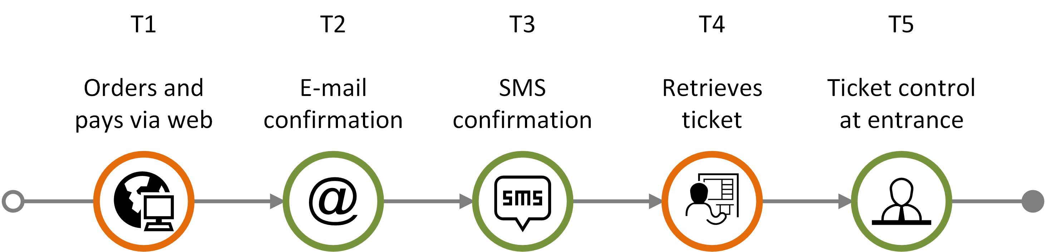
Example journey – "going to the movies"
In the following, an example journey will be used to illustrate different features of the customer journey diagram.
The example journey consists of the following communication points:
  The customer orders and pays a movie ticket via online booking (T1)
  The customer receives a confirmation via e-mail (T2)
  The customer receives a confirmation via SMS (T3)
  The customer retrieves the ticket via a self-service machine at the movie theatre (T4)
  The customer shows the ticket at the entrance (T5)
This example journey is only one out of many alternative ways a "movie journey" could be realized.
Overview
Symbols
Customer journey diagram
Journey network diagram
Customer experience
Appendix

Slide 53
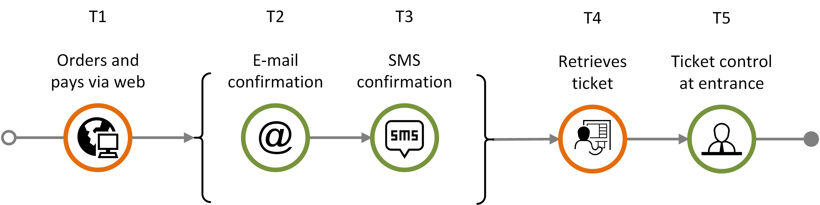
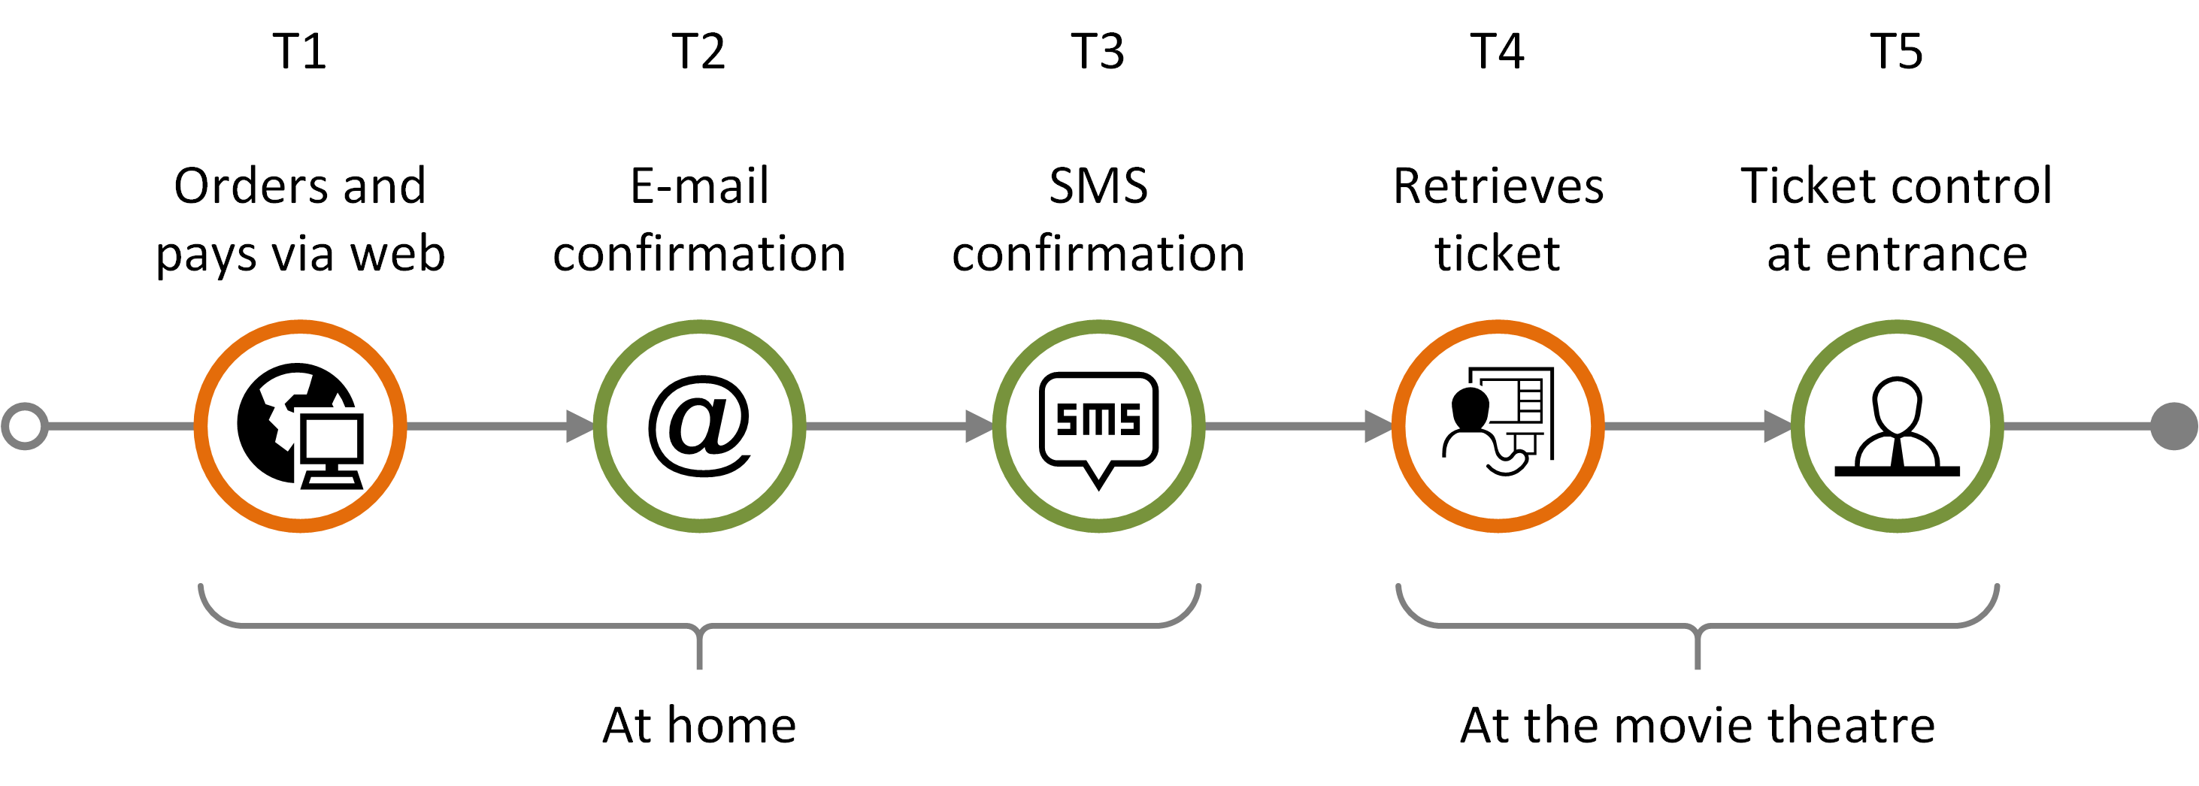
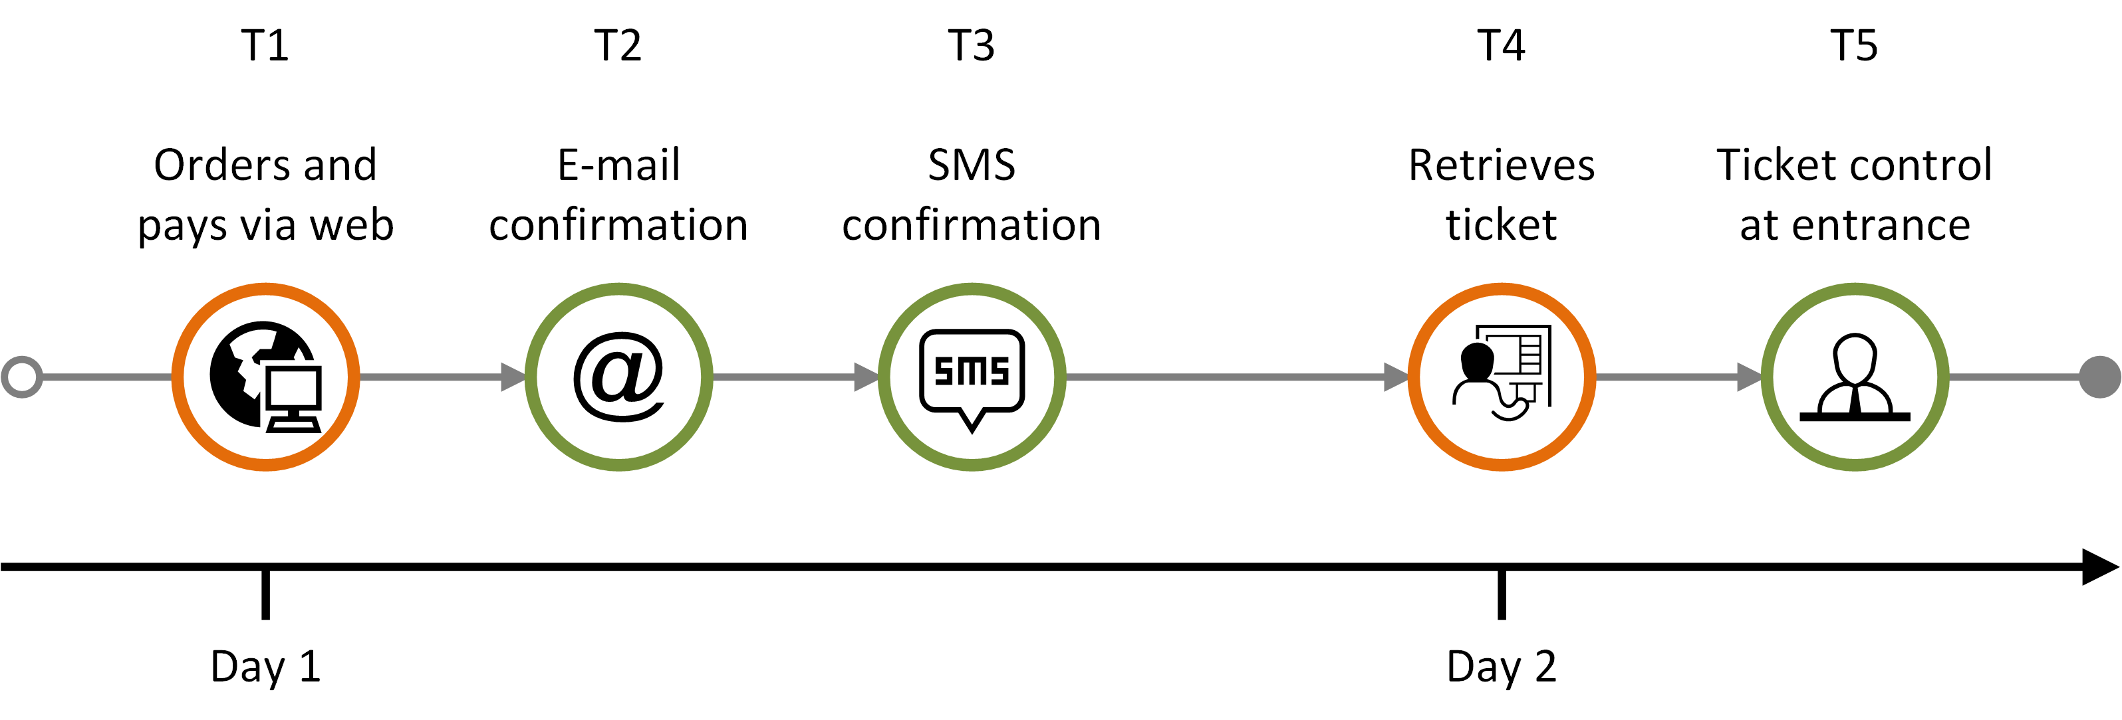
Features – plain journey diagram (1)
planned journey
Planned customer journey containing an unordered sequence (brackets)
Planned customer journey consisting of a sequence in chronological order, with journey phase
Planned customer journey consisting of a sequence in chronological order, with a timeline
Overview
Symbols
Customer journey diagram
Journey network diagram
Customer experience
Appendix

Slide 54
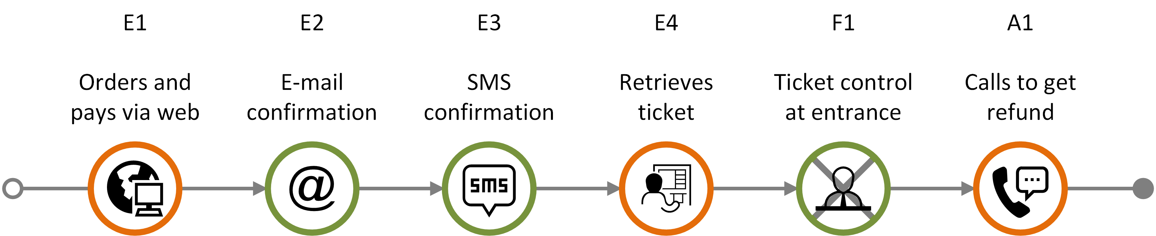
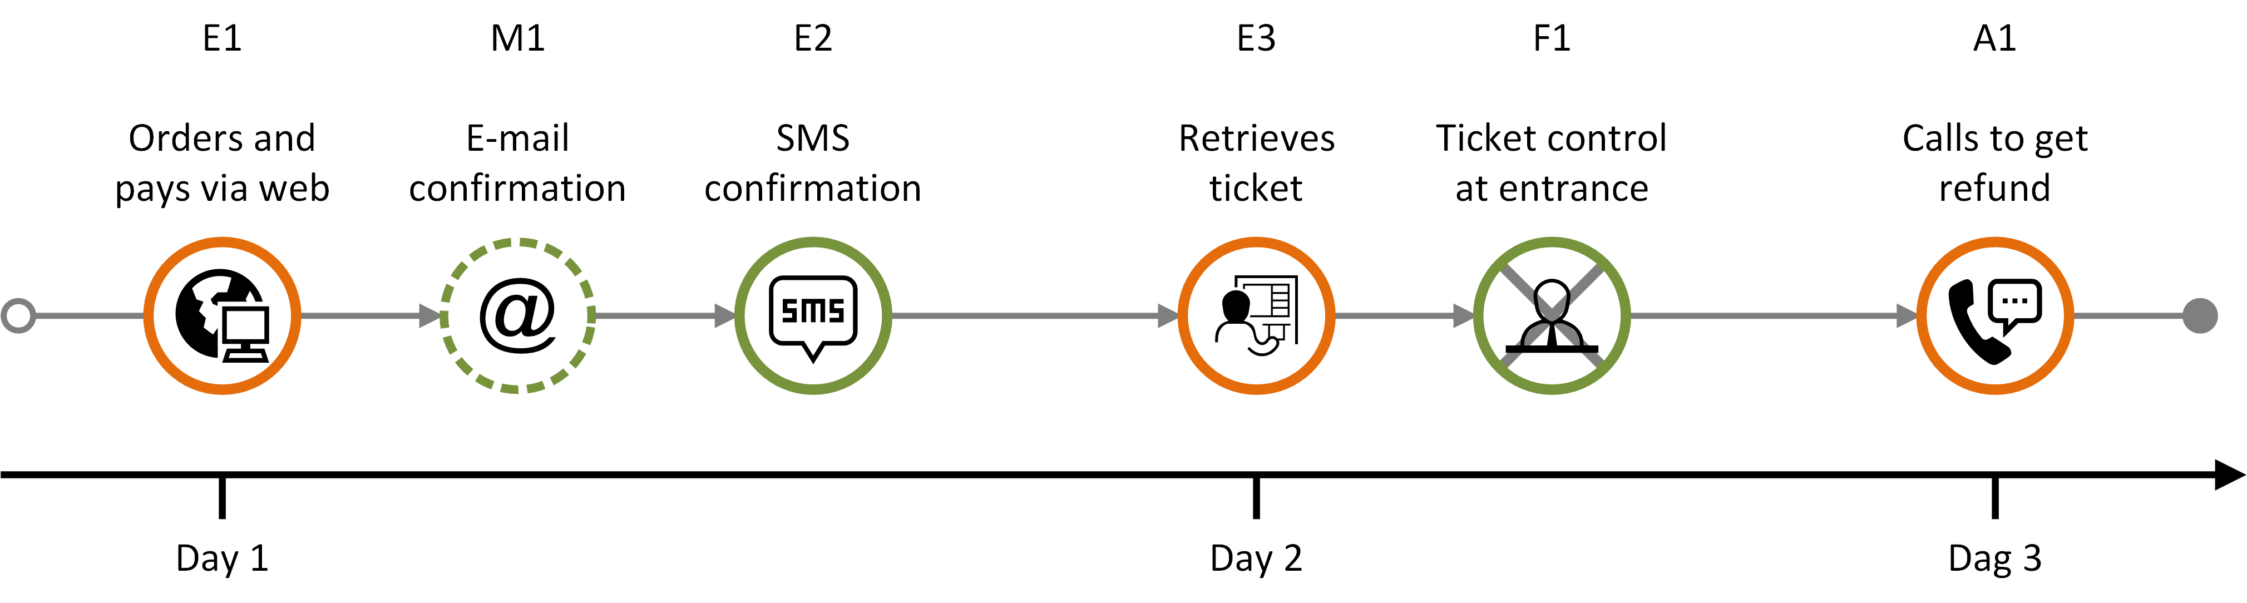
Features – plain journey diagram (2)
actual journey
failing
communication point
ad-hoc
communication point
Actual journey consisting of:
four completed expected communication points (E1-E4)
one failing communication point (F1)
one ad-hoc communication point (A1)
missing communication point
failing
communication point
ad-hoc communication point
Actual journey with timeline consisting of:
three completed expected communication point (E1-E3)
one missing communication point (M1)
one failing communication point (F1)
one ad-hoc communication point (A1)
Overview
Symbols
Customer journey diagram
Journey network diagram
Customer experience
Appendix

Slide 55

Deviation diagram - basics
actual journey
Expected and deviating touchpoints are shown in two different layers.
Missing communication points that are part of the planned journey appear as grey "ghost" symbols in the upper level
E1
E2
E3
The expected elements appear above the line
When a deviation follows as a direct consequence of an ad-hoc, missing, or failing element, it is displayed vertically below the touchpoint it originated from.
Otherwise, it should be positioned besides the preceding touchpoint
M1
F1
The deviations (ad-hoc, missing and failing touchpoints) are shown below the line.
Missing and failing communication points that are part of the planned journey appear in the lower "deviations" level showing status and initiator
A1
Overview
Symbols
Customer journey diagram
Journey network diagram
Customer experience
Appendix

Slide 56
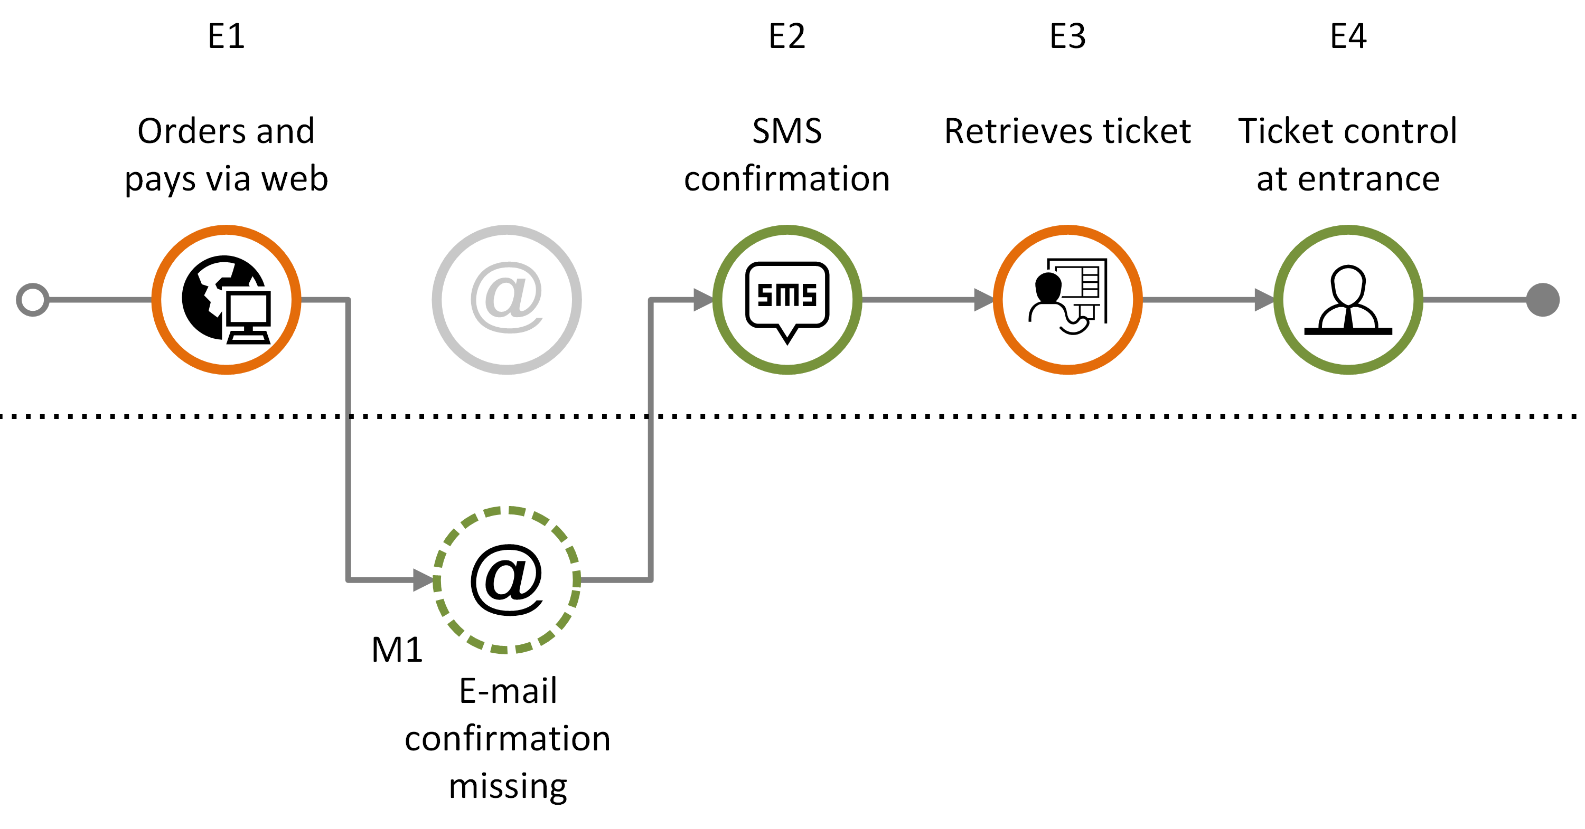
Deviation diagram: Missing touchpoint
actual journey
Customer journey consisting of a sequence of expected communication points (E1-E4) and with one missing communication point (M1).
Overview
Symbols
Customer journey diagram
Journey network diagram
Customer experience
Appendix

Slide 57
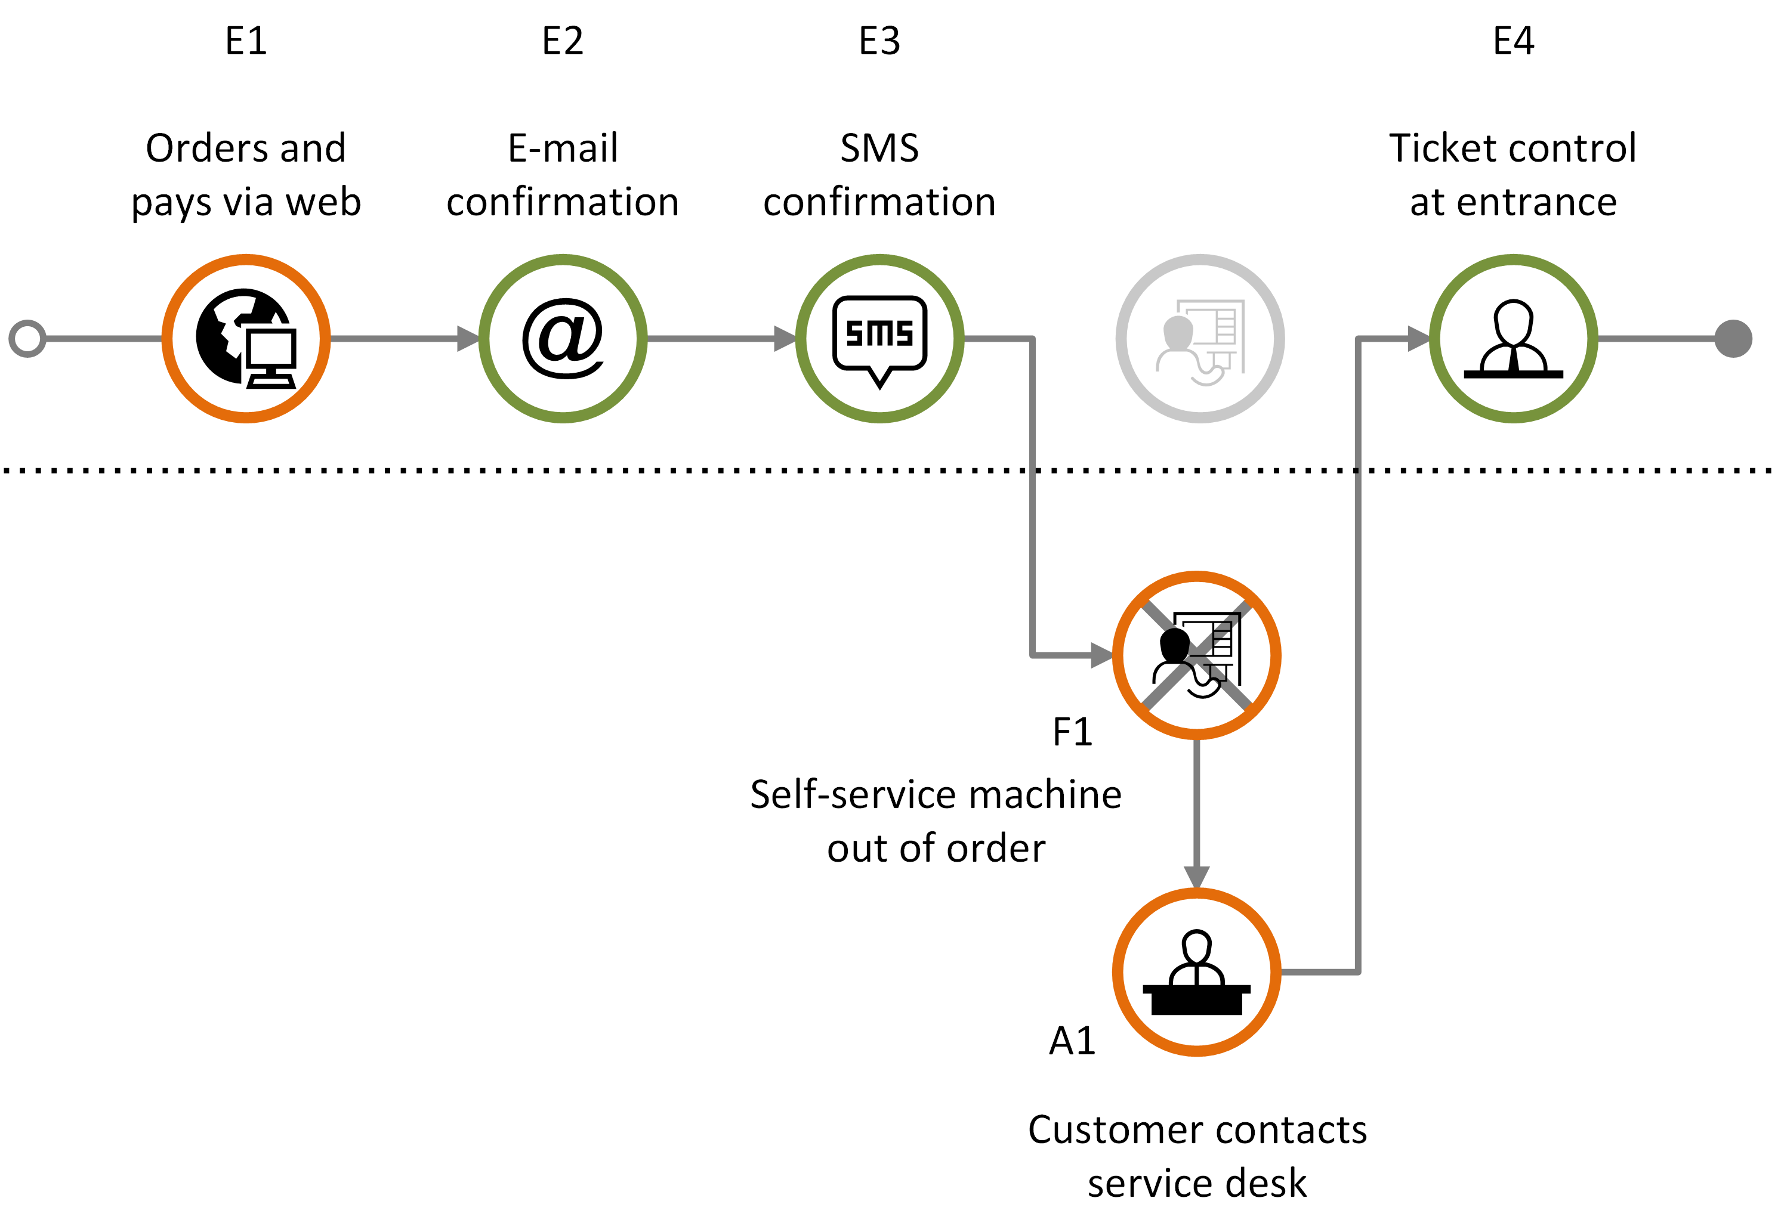
Deviation diagram: Failing and ad-hoc touchpoint
actual journey
Customer journey consisting of expected communication points (E1-E4), with one failing communication point (F1) that in turn generates an ad-hoc communication point (A1).
Overview
Symbols
Customer journey diagram
Journey network diagram
Customer experience
Appendix

Slide 58
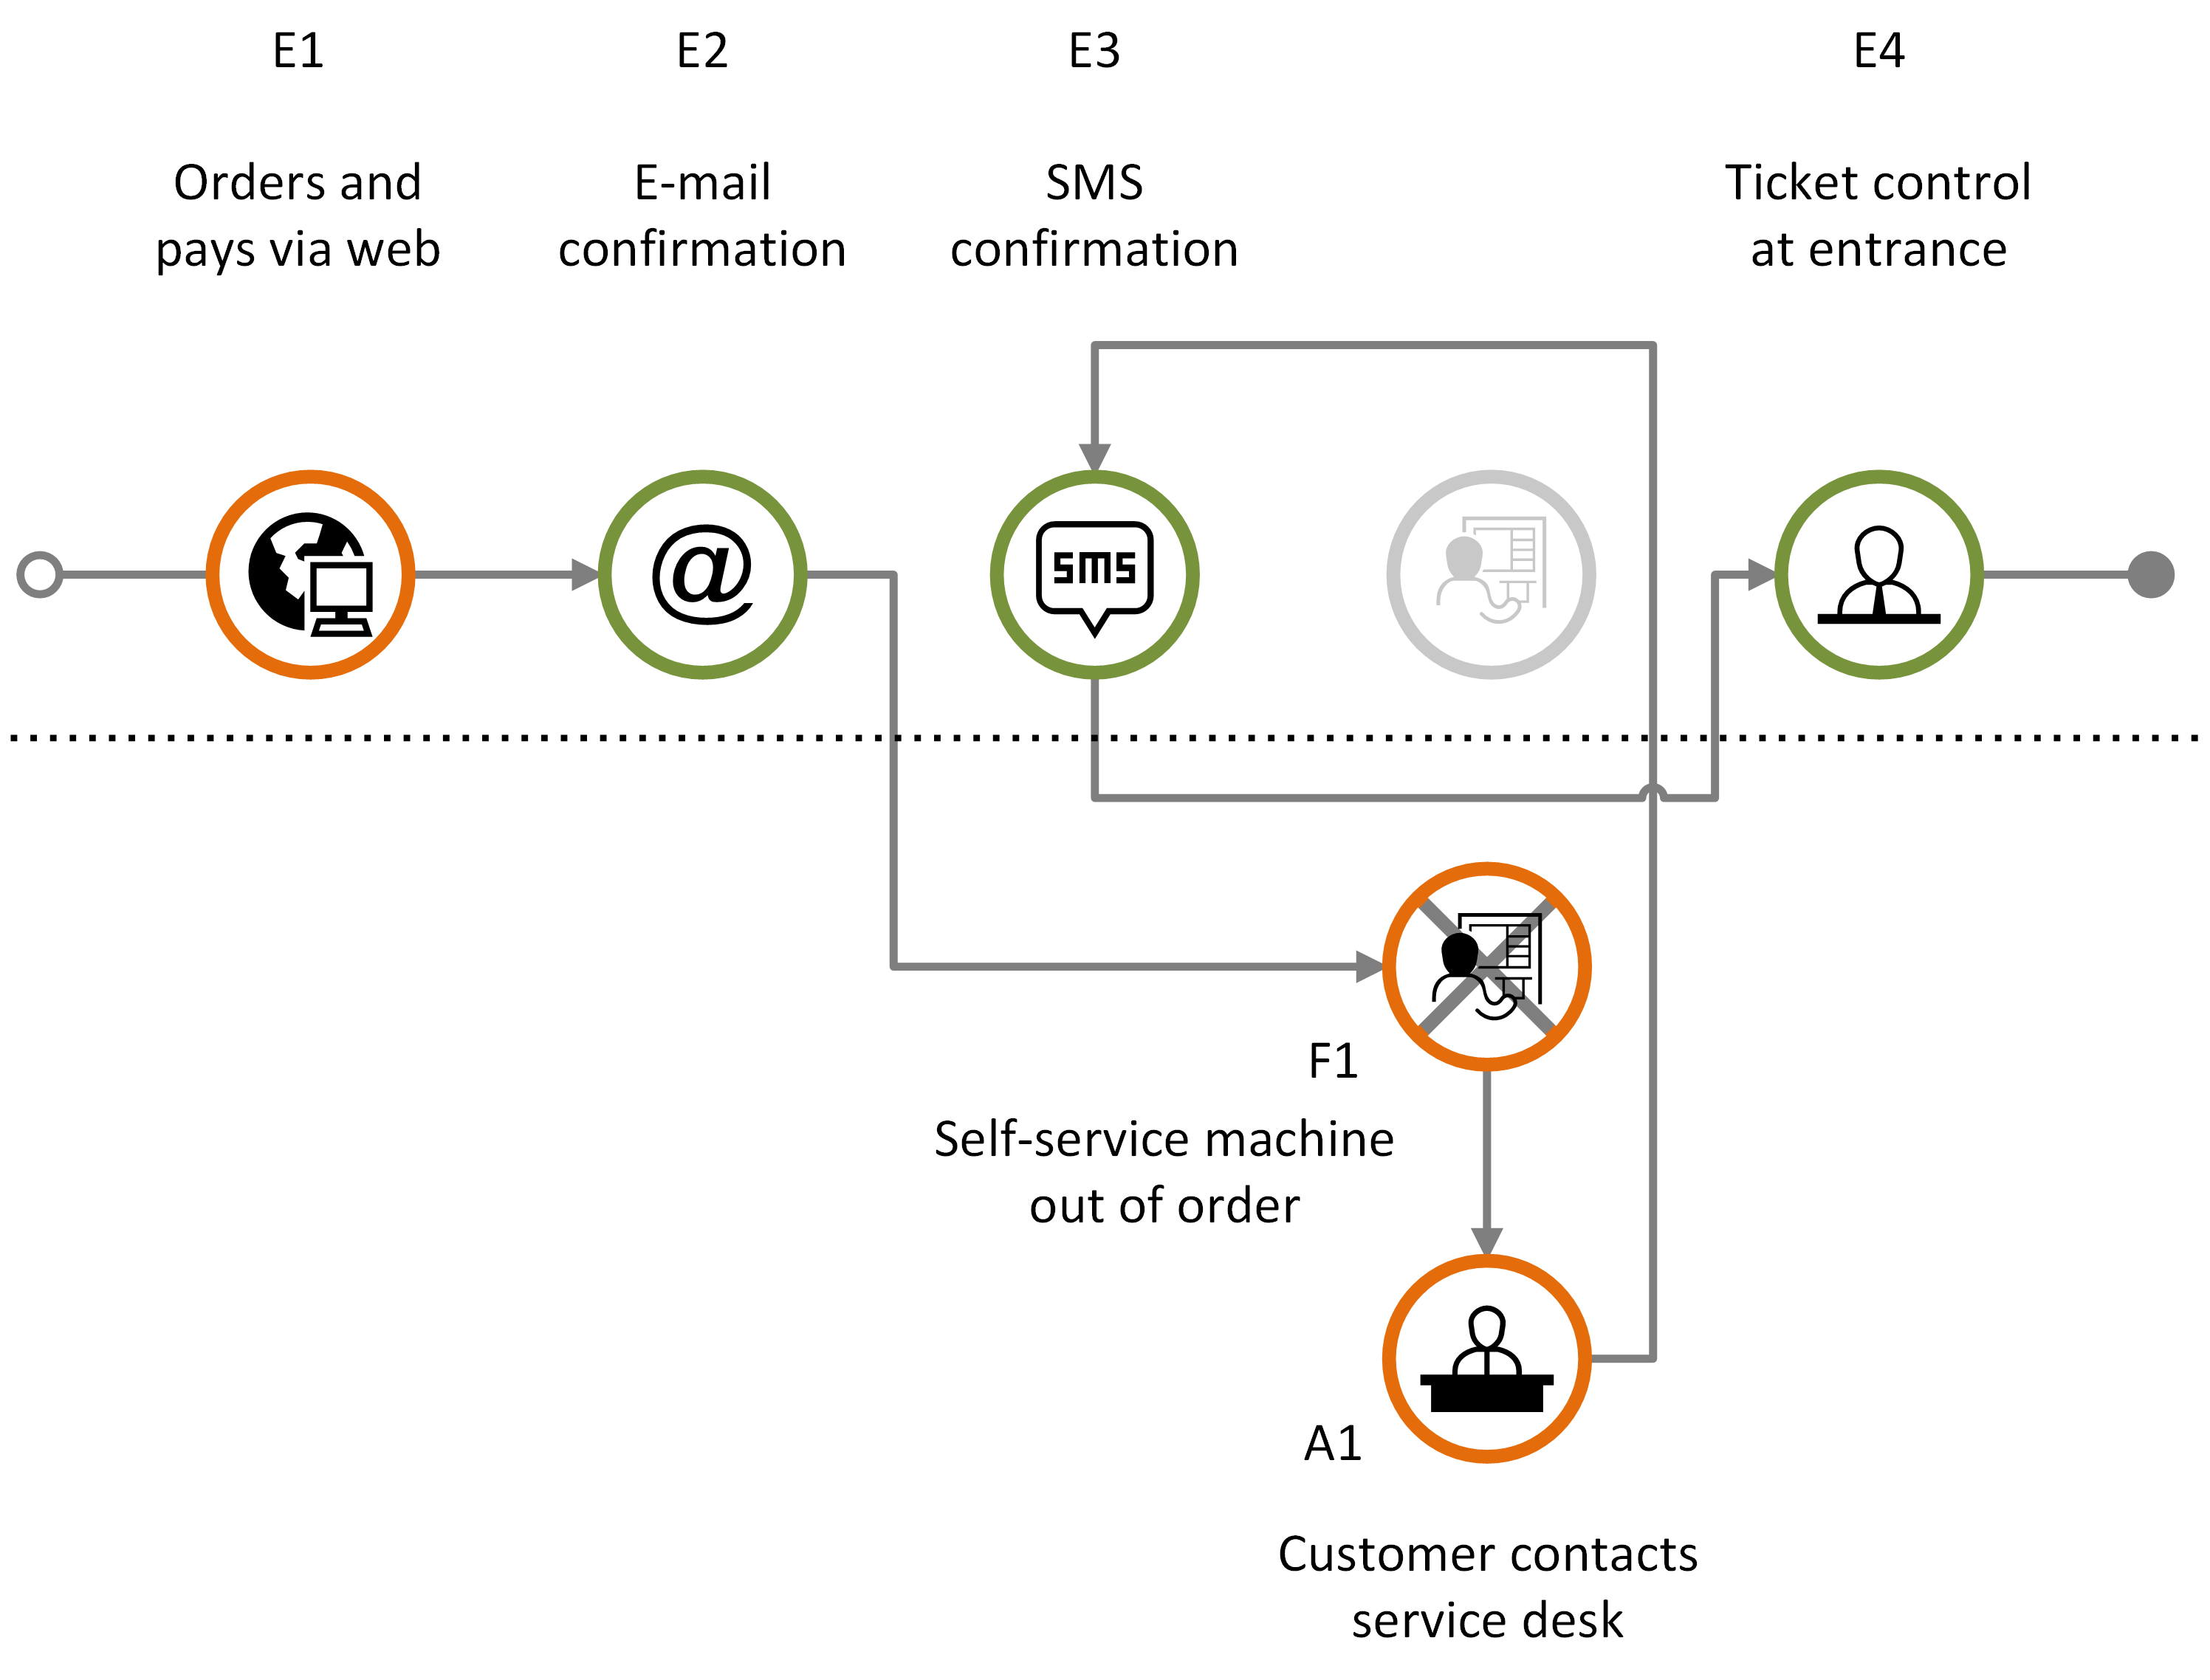
Deviation diagram: sequence error
actual journey
Customer journey including sequence errors and one failing element (F1) that in turn generates an ad-hoc communication point (A1).
Overview
Symbols
Customer journey diagram
Journey network diagram
Customer experience
Appendix

Slide 59





Example planned journey - part 1 of 2
Planned journey
Planned journey of ordering electricity from a utility company.
Receives call from telemarketing and agrees to electricity deal
Receives request for agreement confirmation and meter reading
Reads
the meter
Sends agreement confirmation and meter reading
Receives info about the agreement being processed
Customer
Calls the customer and offers electricity deal
Sends request for agreement confirmation and meter reading
Receives agreement confirmation and meter reading
Customer info is sent to power supplier
Tele-
marketing
Receives customer info
Sends info about the agreement being processed
Power supplier
Grid company
Bank-
related
Overview
Symbols
Customer journey diagram
Journey network diagram
Customer experience
Appendix

Slide 60


Example planned journey - part 2 of 2
Planned journey
Planned journey of ordering electricity from a utility company.
Receives welcome call
Receives meter reading notification
Reads
the meter
Sends
the meter
Receives invoice
Pays invoice
Customer
Tele-
marketing
Calls customer for a welcome call
Receives payment
Power supplier
Sends notification for meter reading
Receives the meter reading
Sends invoice to be forwarded to customer
Grid company
Receives invoice to be forwarded to customer
Invoice ready for customer
Bank-
related
Overview
Symbols
Customer journey diagram
Journey network diagram
Customer experience
Appendix

Slide 61
Example actual journey - part 1 of 2
Actual journey
Missing communication point: The SMS about the agreement being processed is no received
Actual journey of ordering electricity from a utility company.
Receives call from telemarketing and agrees to electricity deal
Receives request for agreement confirmation and meter reading
Reads
the meter
Sends agreement confirmation and meter reading
Receives info about the agreement being processed
Customer
Calls the customer and offers electricity deal
Sends request for agreement confirmation and meter reading
Receives agreement confirmation and meter reading
Customer info is sent to power supplier
Tele-
marketing
Receives customer info
Sends info about the agreement being processed
Power supplier
Grid company
Bank-
related
Overview
Symbols
Customer journey diagram
Journey network diagram
Customer experience
Appendix

Slide 62
Example actual journey - part 2 of 2
Actual journey
Failing communication point: The customer fails to send the meter reading.
Actual journey of ordering electricity from a utility company.
Receives welcome call
Receives meter reading notification
Reads
the meter
Sends
the meter
Receives invoice
Pays invoice
Customer
Tele-
marketing
Calls customer for a welcome call
Receives payment
Power supplier
Sends notification for meter reading
Receives the meter reading
Sends invoice to be forwarded to customer
Grid company
Receives invoice to be forwarded to customer
Invoice ready for customer
Bank-
related
Overview
Symbols
Customer journey diagram
Journey network diagram
Customer experience
Appendix

